Slide 1




Optimizing Autorotating Sensor Probe Design for Space Exploration
Sebastian Castillo-Sotelo
Mentored by Dr. Jnaneshwar Das with contributions from Darwin Mick and Cole Brauer
Arizona Space Grant Consortium

Slide 2
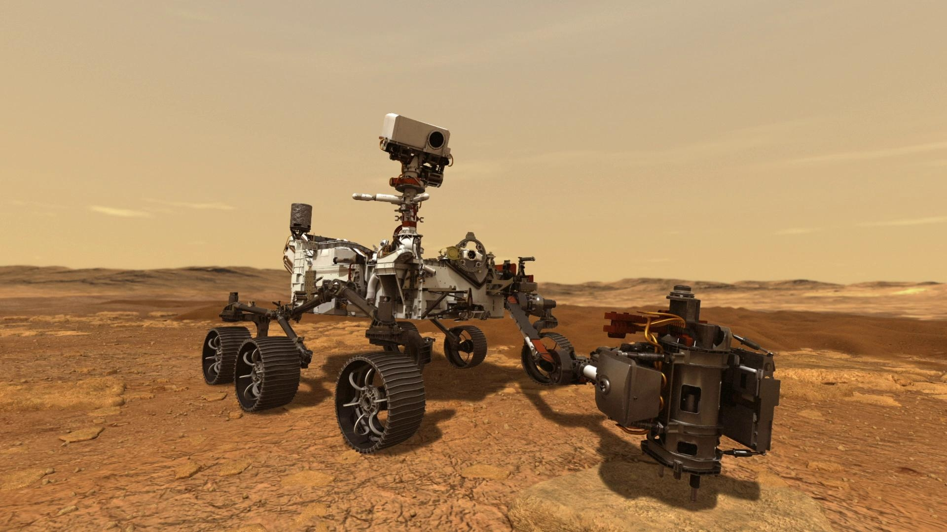

Problem statement
It is an important objective to study other planets and learn as much as we can from them.
different kinds of technology have been developed in order to accomplish that(telescopes, satellites, Mars rover vehicles, etc.).
We want an effective and inexpensive way to collect planetary surface data to supplement what we already have.
Source: https://mars.nasa.gov/mars2020/

Slide 3
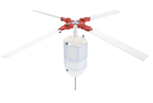

Objective
The purpose of this project is to develop a sensor pod that’s capable of utilizing autorotation to safely land on the planets surface
The Marspod is designed to so that the rotor blades begin to spin on its own when it is dropped from a certain altitude

Slide 4
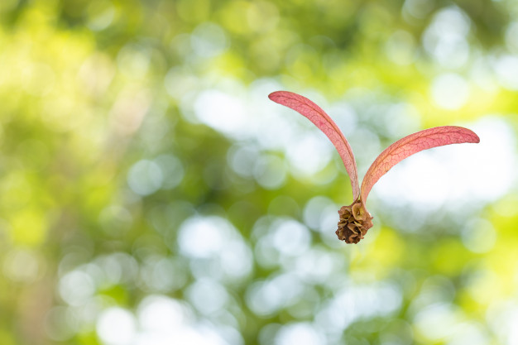
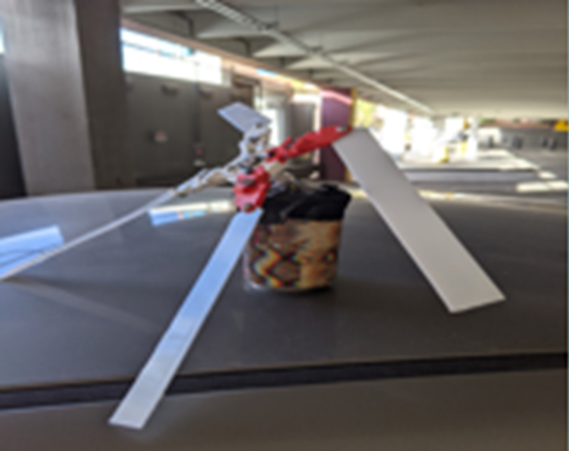
Methods and activities
Research about the aerodynamics of falling seeds like the dipterocarp seed were studied to understand the physics and principles of autorotation.
A cheap test model was made from an aluminum can and dropped to see if the rotor blades would spin up.
A Newtonian model of the Marspod was derived where the aerodynamic forces were described and made into equations of motion that could model the behavior of the Marspod in flight.
https://www.freepik.com/premium-photo/dipterocarpus-intricatus-seed-falling-from-tree_2408016.htm

Slide 5
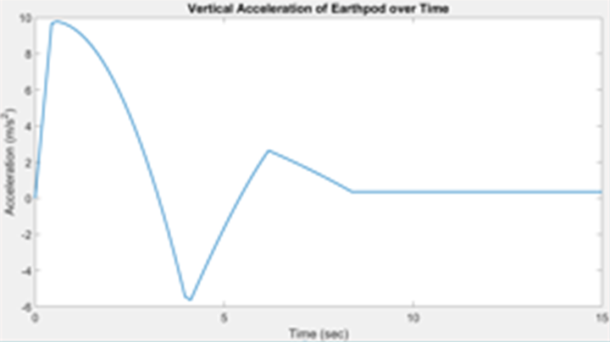
Results
It was observed that the blades did begin to spin and showed signs of slowing down, but the model still hit the ground hard
The plot shows how the acceleration of the Marspod would initially increase, but eventually reach 0. This trend is consistent with the results that other researchers have obtained.

Slide 6
Significance of results and next steps
The Marspod is starting to work the way it was designed, but still needs more optimization before it can be used.
An algorithm was created that can calculate and describe the aerodynamics of the Marspod and model its flight.
More research needs to be done on how to design the Marspod so that it can control itself while its descending in the atmosphere.

Slide 7
Acknowledgements
Mentor: Dr. Jnaneshwar Das
Lab mates: Darwin Mick and Cole Brauer
Space Grant Program

Slide 8
Thank You!!!

